Slide 1

Nextgen solutions
Building and implementing an airport network INFRASTRUCTURE

Slide 2






Airport Requirements
Network
Connection
To PE airport
Networked PCs
For shops
Cameras
Internet Access
Central Server

Slide 3
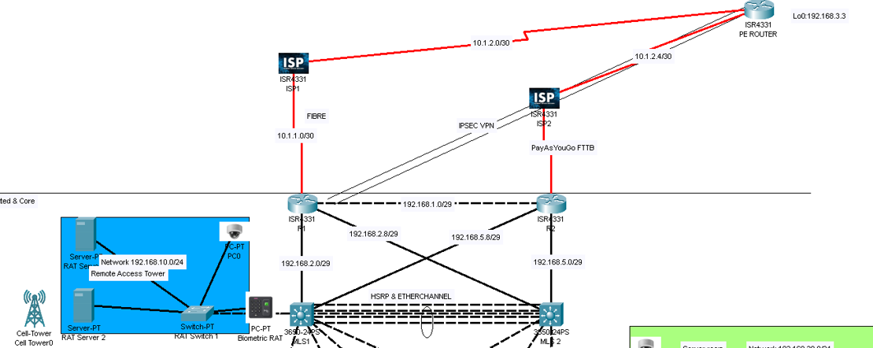
Proposed topology

Slide 4
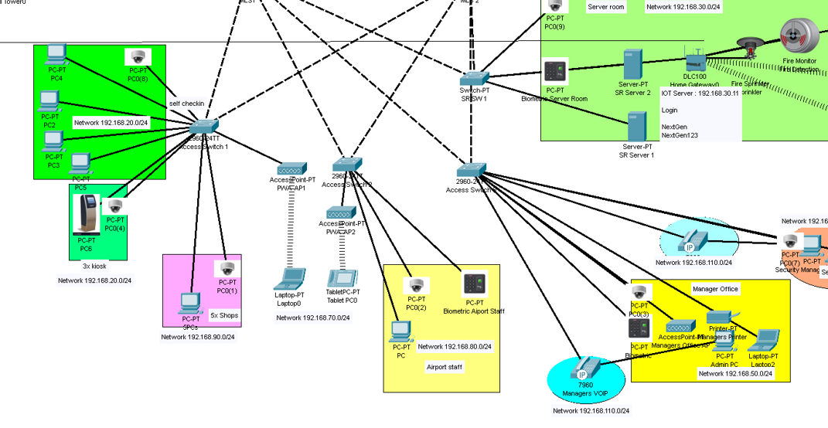

Slide 5
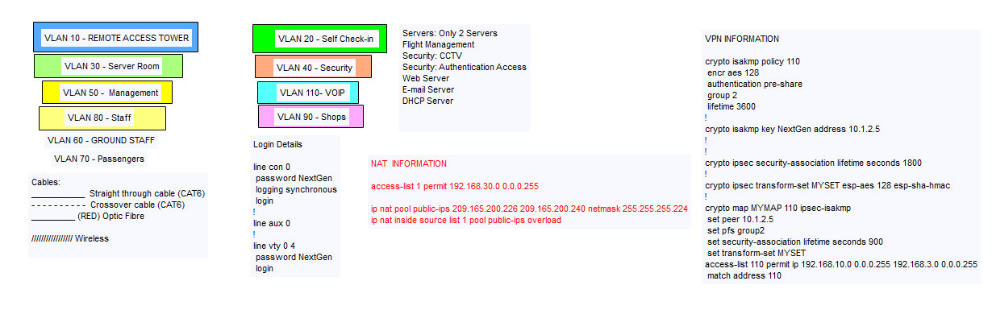

Slide 6
Gantt chart overview
Preparation : 2022/09/05 – 2022/09/09
Includes drilling of holes, CCTV system setup, biometrics, fire suppression.
Server Room Setup : 2022/09/05 – 2022/09/09
Floor lifting, drilling server mounts, mount racks, air conditioning , cleaning, installing Servers & firewall
Cable Room & Trunking : 2022/09/08 – 2022/09/26
Cabling of all rooms in the building
Configuration of Network : 2022/09/22 – 2022/09/28
MLS, Access Switches, Servers & Routers
Network Testing : 2022/09/29 – 2022/10/04
System Hand Over : 2022/09/05

Slide 7
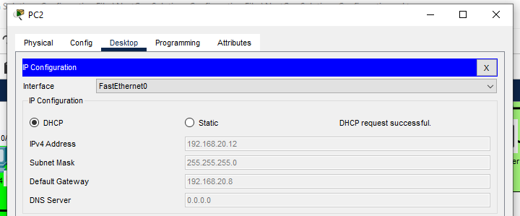
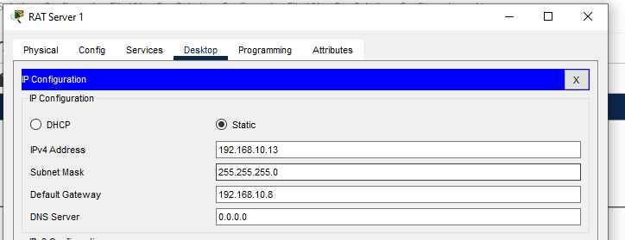
Ip ADDRESSING
DHCP
STATIC IP
Used to assign IP addresses with VLAN tag to network devices.
For security reasons, servers have been assigned static IP address

Slide 8
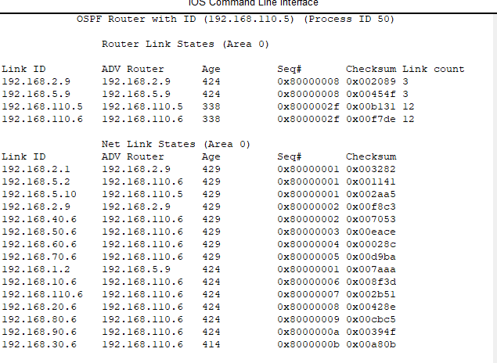
Routing
OSPF

Slide 9
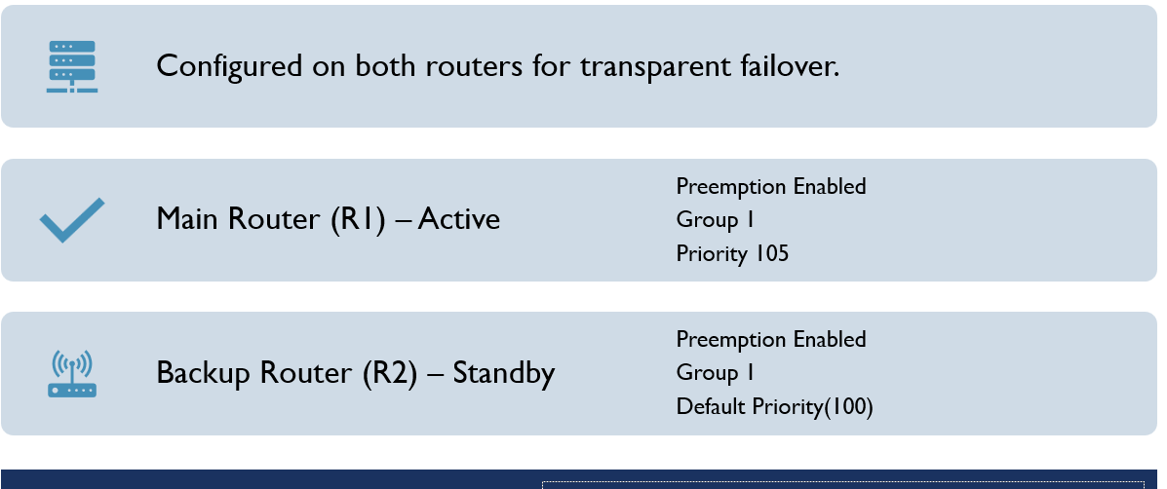
HSRP

Slide 10
ZONE BASED FIREWALL
Configured with two zones, the Inside & Outside zones.
Inside to Outside Protocols:
Icmp
http
https
ftp
Outside to Inside Protocols:
Icmp
ftp

Slide 11
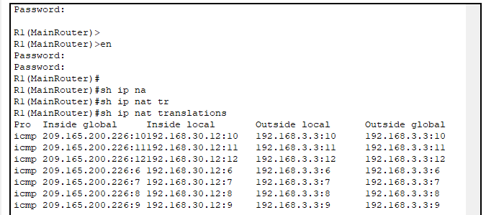
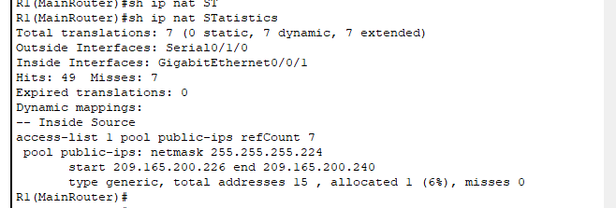
Nat translations & statistics

Slide 12
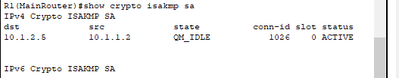
Vpn tunnel
VPN Tunnel between the Main Router & PE Airport Router.
Phase 1
Policy 110
Encryption AES (128 bits)
Authentication Pre-shared (NextGen)
DH group 2
Lifetime 3600
Phase 2
transform-set MYSET esp-aes 128 esp-sha-hmac

Slide 13

Thank You
QUESTIONS ?

